Slide 1
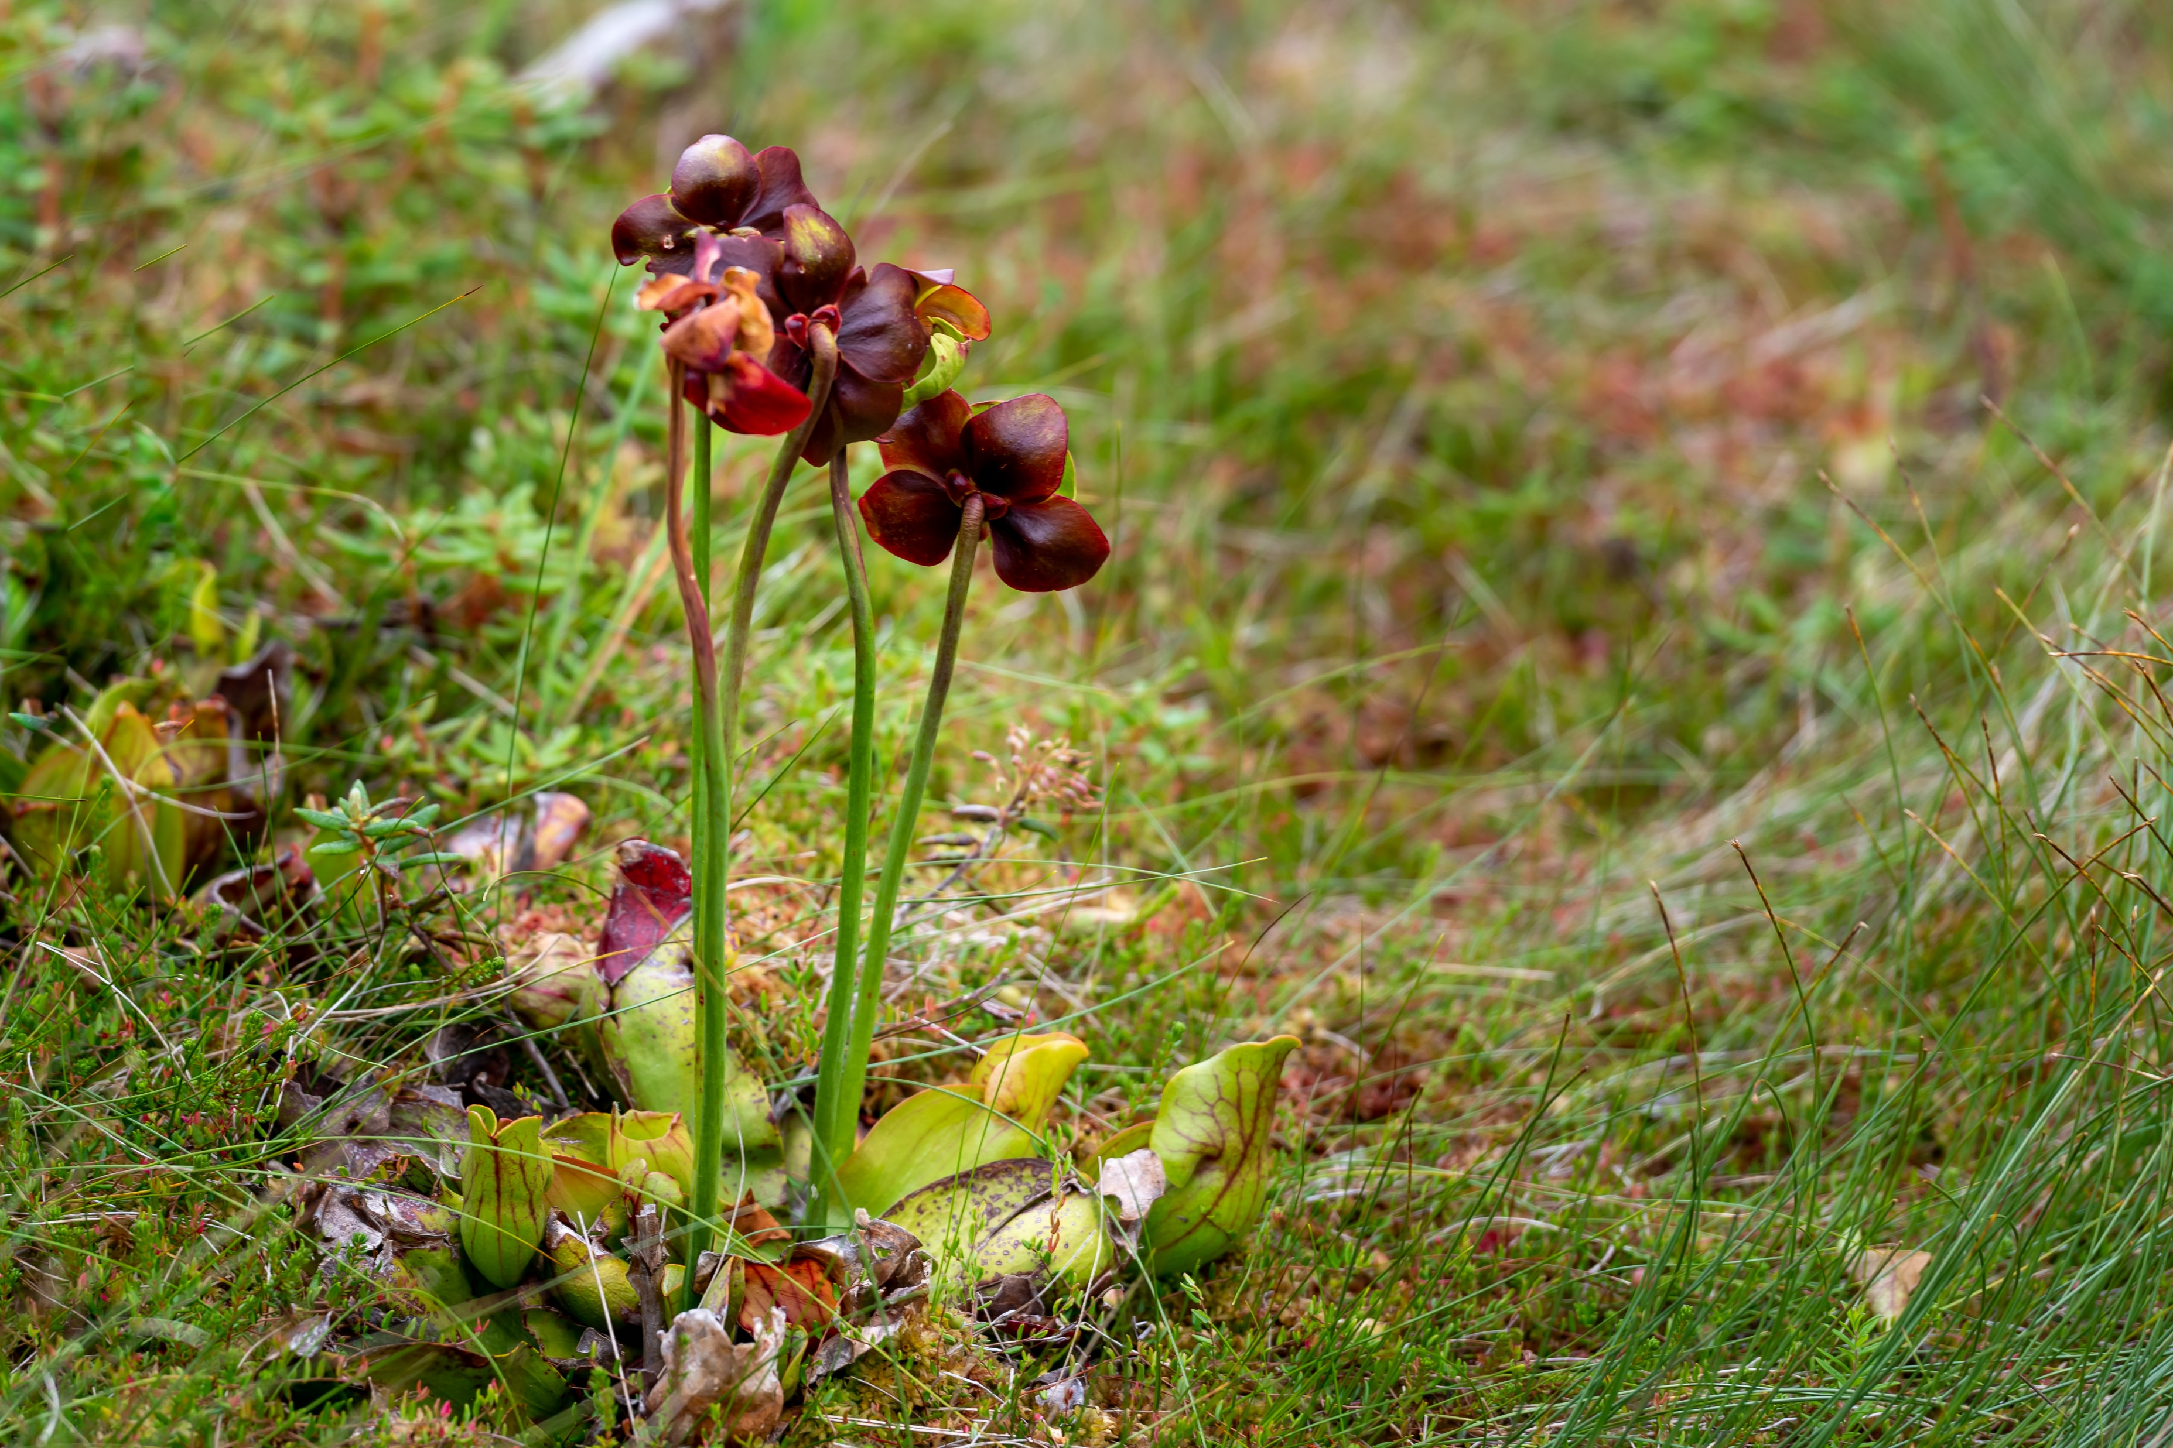
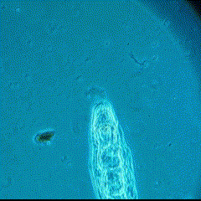

The search for indirect ecological effects of evolution in pitcher plant rotifers
Alex Mendelson
Alex A. Mendelson*, Casey P. terHorst
California State University, Northridge

Slide 2
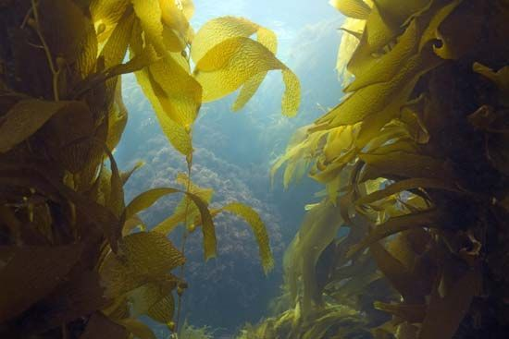
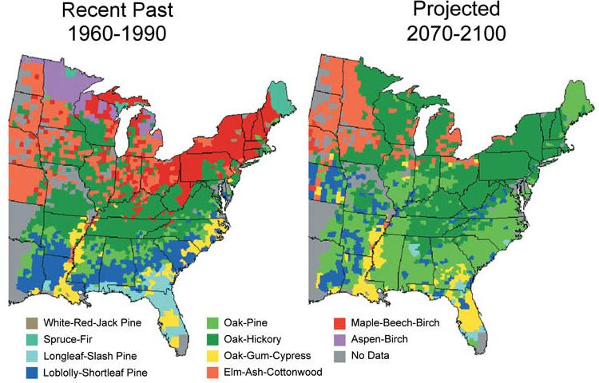
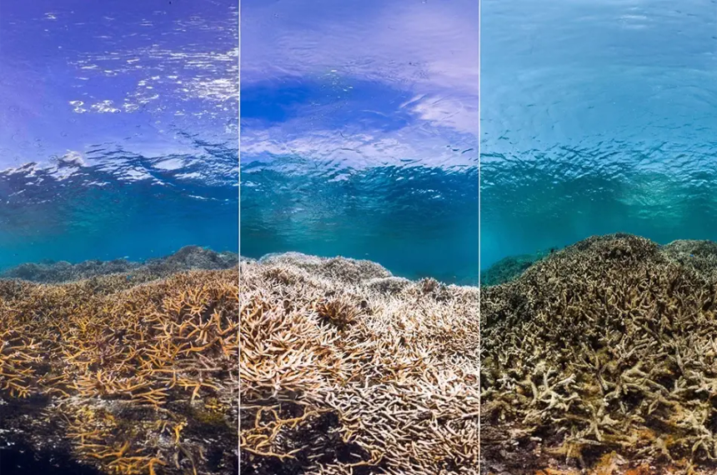
How do you quantify the biological effects of climate change?
Ecological approach
Seasonal processes
Range shifts
Species interactions

Slide 3
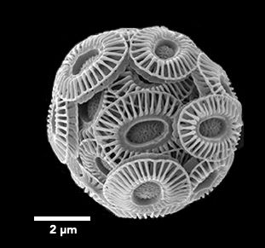
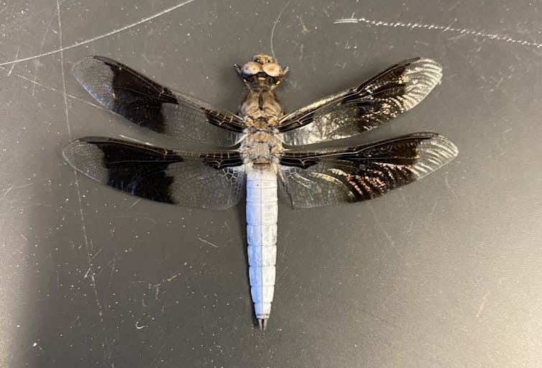
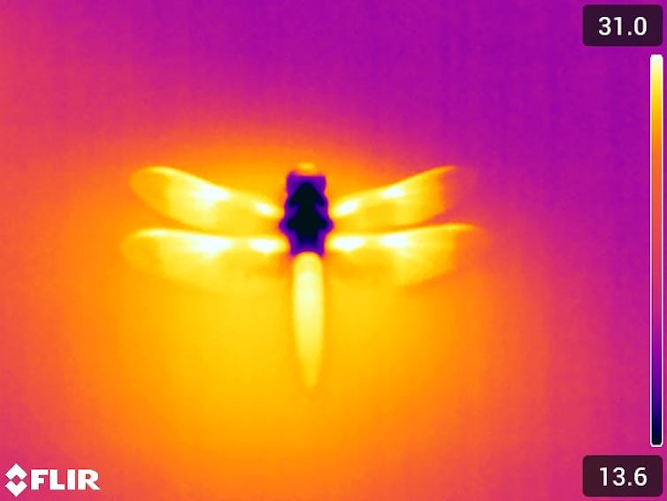
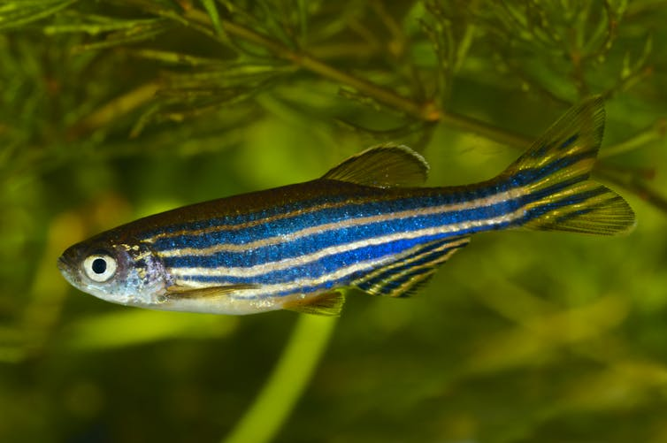
How do you quantify the biological effects of climate change?
Evolution
Adaptation to ↑pCO₂
Selection trade-offs
Thermal tolerance

Slide 4

Eco-evo effects
Species A
Species B
Higher Temp
Interaction
evolution
Climate Change
Indirect effect
Notes:
Have A change color when you say “A evolved”
Scratch prev slide
Change title (eco evo effects)

Slide 5
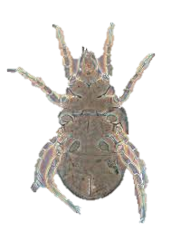
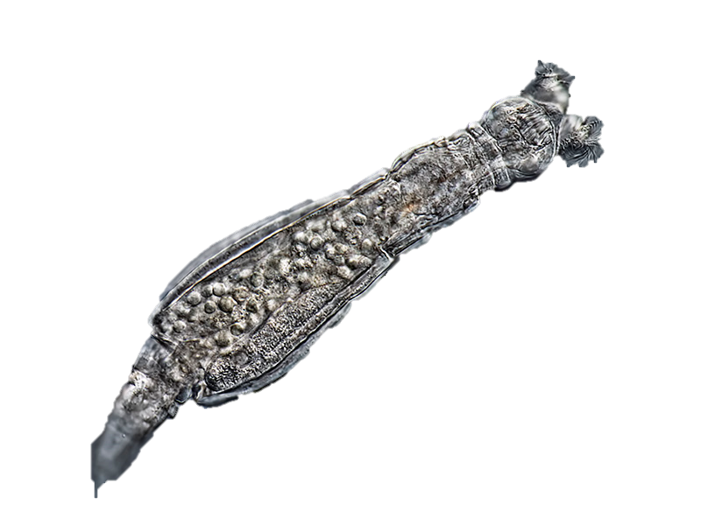
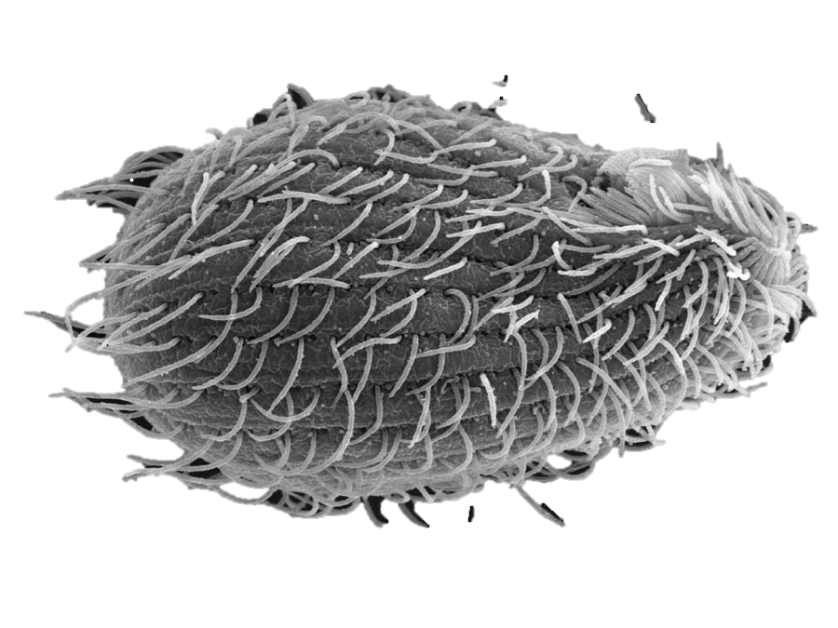

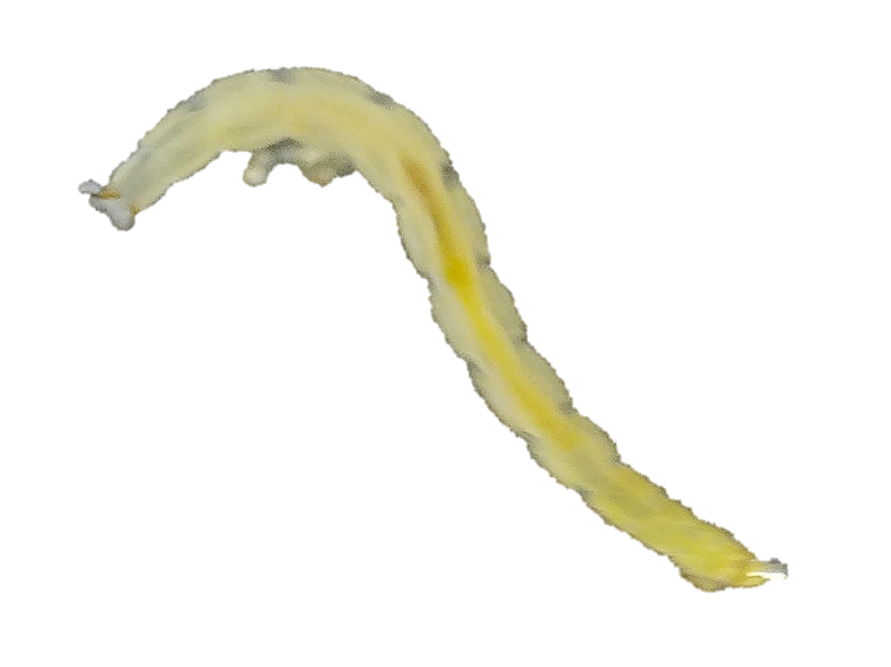
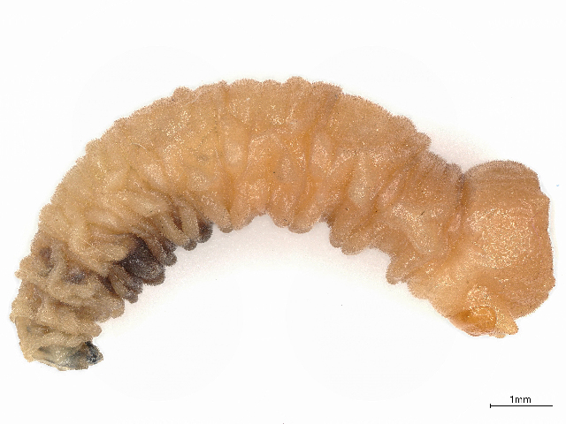
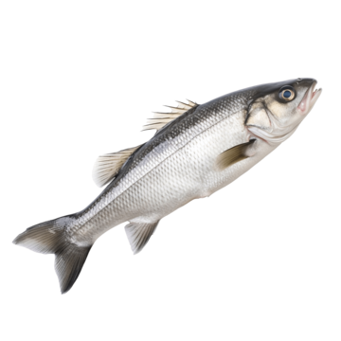
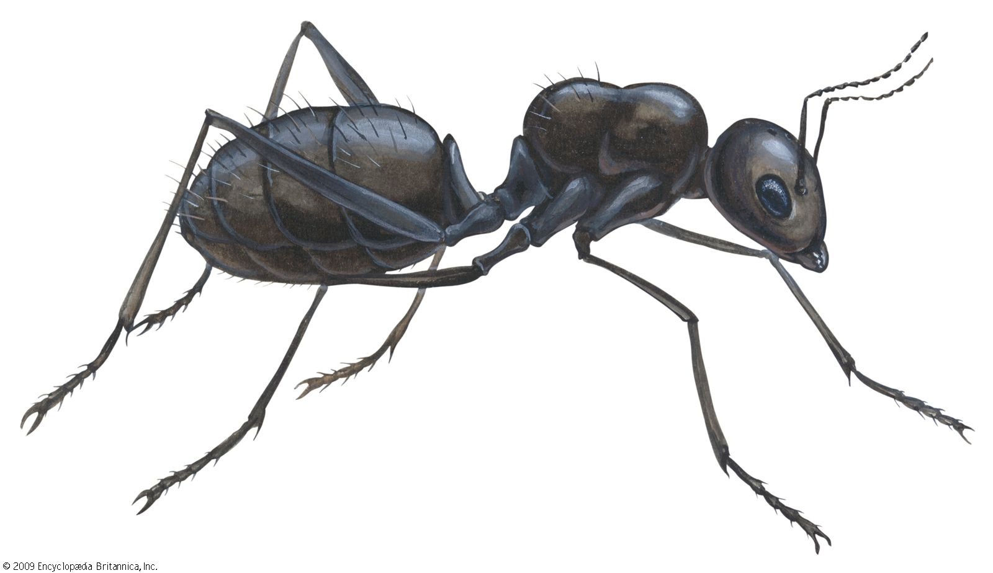
Pitcher plant leaf water community
Bacterivores
Omnivores
Rotifers
Protists
Mites
Bacteria
Sarracenia purpurea
Detritivores
Purple pitcher plant
Digestive
enzymes
Prey
Midge & Fly Larvae
Notes:
Talk about effects of temp on pitcher plants a bit

Slide 6
Pitcher plant leaf water community
Bacterivores
Omnivores
Rotifers
Protists
Mites
Bacteria
Sarracenia purpurea
Detritivores
Purple pitcher plant
Digestive
enzymes
Prey
Midge & Fly Larvae
Notes:
Talk about effects of temp on pitcher plants a bit

Slide 7
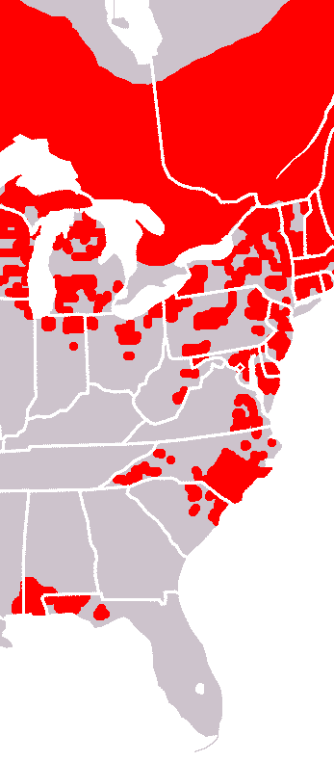
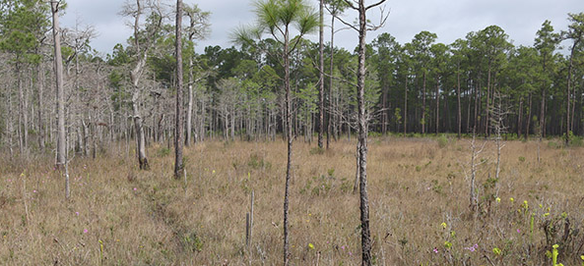
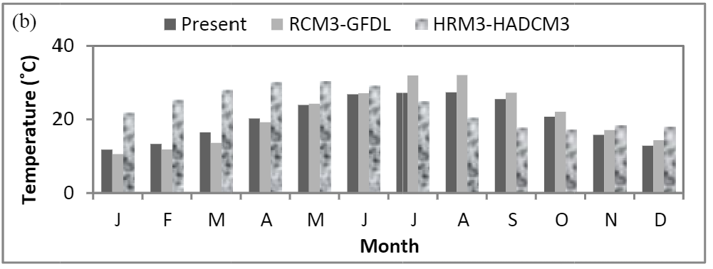
Temperature increase predicted for populations of S. purpurea
Rob Diaz De Villegas
Apalachicola National Forest
Chen et al., 2014
Valemaxxx, Adobe Stock

Slide 8
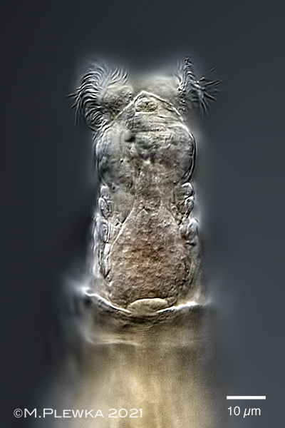
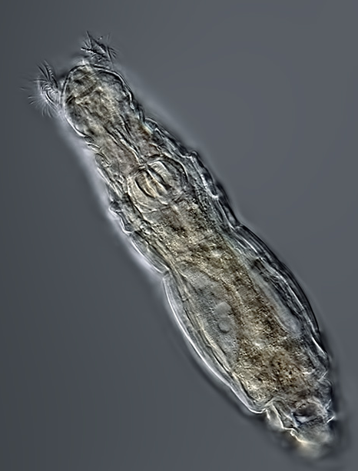
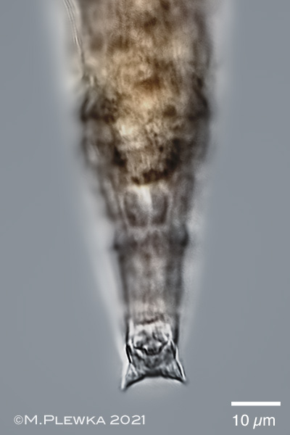
Habrotrocha rosa
Bacterivores
Rotifers
Protists
Michael Plewka
Bacteria
Prey
25 µm
Michael Plewka
Michael Plewka

Slide 9
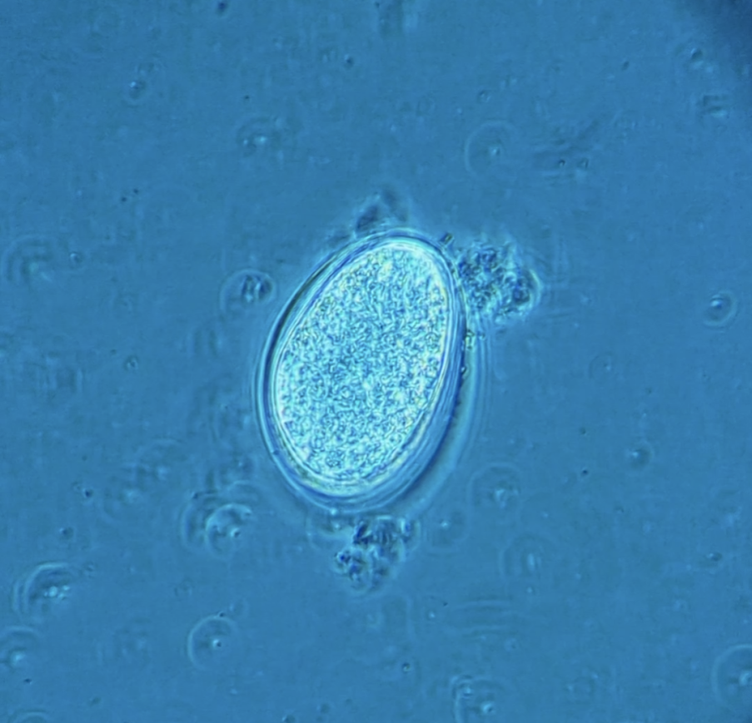
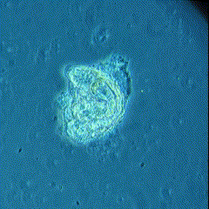
Habrotrocha rosa
Obligately parthenogenetic (apomixis) Offspring are clonal
Generation time 1–2 days
Egg (~6 hours)
Hatching (~12 hours)
Adult (~24-48 hours)

Slide 10
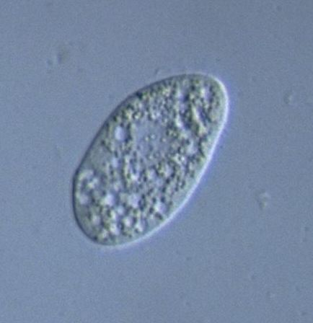
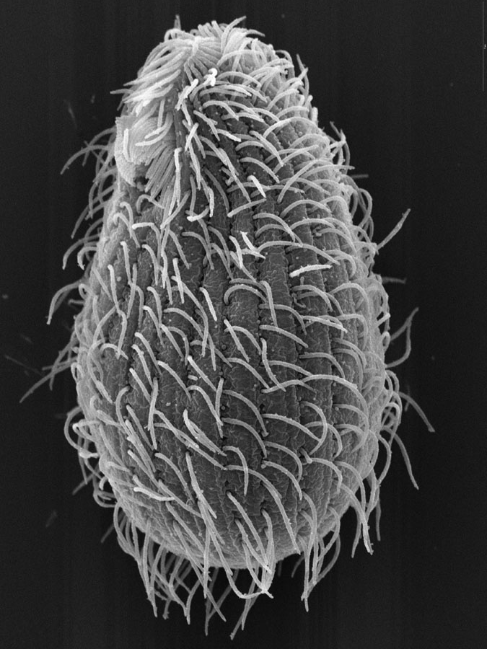
Natural competitor: Tetrahymena sp.
Bacterivores
Competition
Rotifers
Protists
Bacteria
Brian Farley
Y. Tsukii

Slide 11
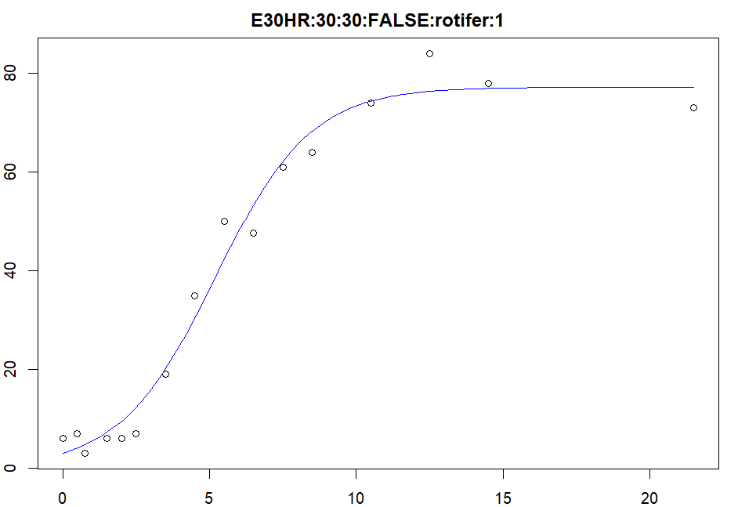
Growth parameters
Habrotrocha rosa and Tetrahymena sp. both have a logistic growth curve
Logistic growth model
Maximum growth rate (r)
Carrying capacity (K)
growthrates package (v.0.8.4) in R (v.4.5.1)
r = 0.6
K = 77
Notes:
Fewer sig figs on r and K
Try full line without breaks, strike day labels, with all 16 timepoints

Slide 12
Rotifers
Protist
Higher Temp
Competition
evolution
Climate Change
?₁
Indirect effect
Do populations of H. rosa evolve in response to temperature?

Slide 13
?₂
Are populations of H. rosa affected by competition with Tetrahymena sp.?
Rotifers
Protist
Higher Temp
Competition
evolution
Climate Change
?₁
Indirect effect
Do populations of H. rosa evolve in response to temperature?

Slide 14
?₂
Are populations of H. rosa affected by competition with Tetrahymena sp.?
Rotifers
Protist
Higher Temp
Competition
evolution
Climate Change
?₁
Indirect effect
?₃
Are there evolution-mediated indirect effects of temperature on competition between H. rosa and Tetrahymena sp.?
Do populations of H. rosa evolve in response to temperature?

Slide 15
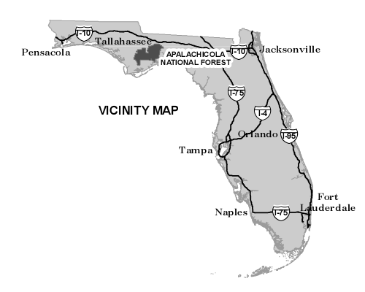
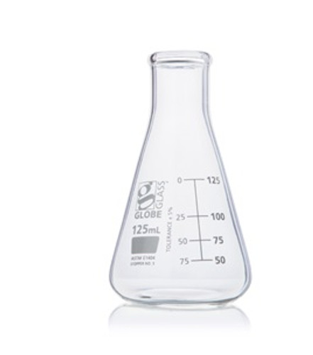
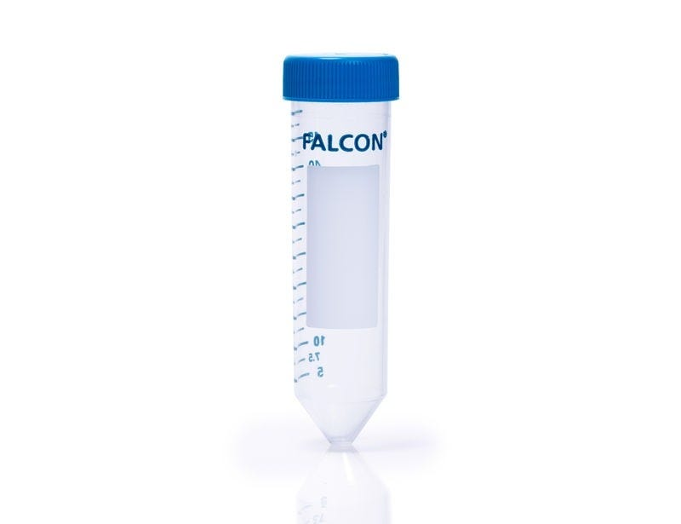
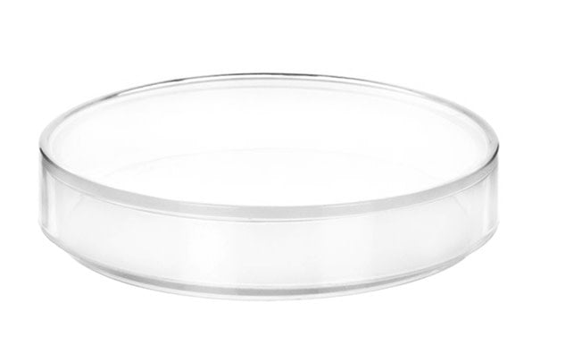
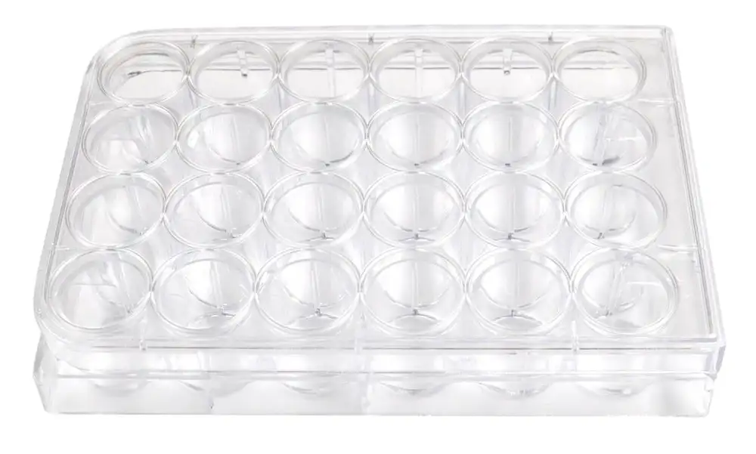
Field Sampling and Isolation
Clonal Cultures
Apalachicola
National Forest
Leaf water
1st Isolation
2nd Isolation
24-well tissue culture plate

Slide 16
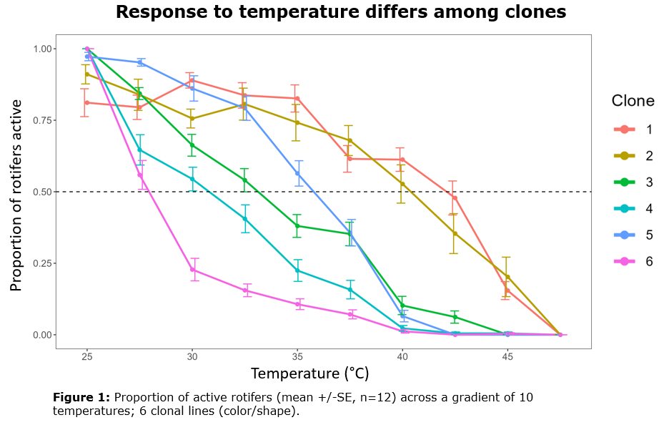

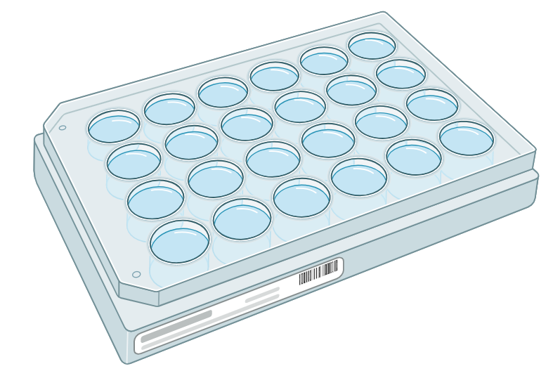
H. rosa clones differ in their response to temperature
Thermal tolerance
Time (h)
0
1
2
3
4
5
6
7
8
9
Active
Encysted
vs
25
30
35
40
45
Temperature (°C)

Slide 17
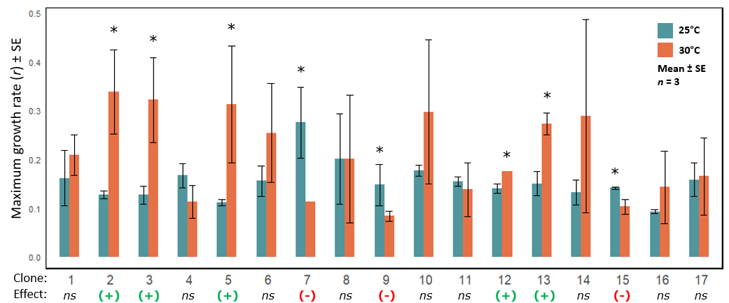
H. rosa clones differ in their response to temperature
Maximum growth rate
Potential for rapid evolution

Slide 18
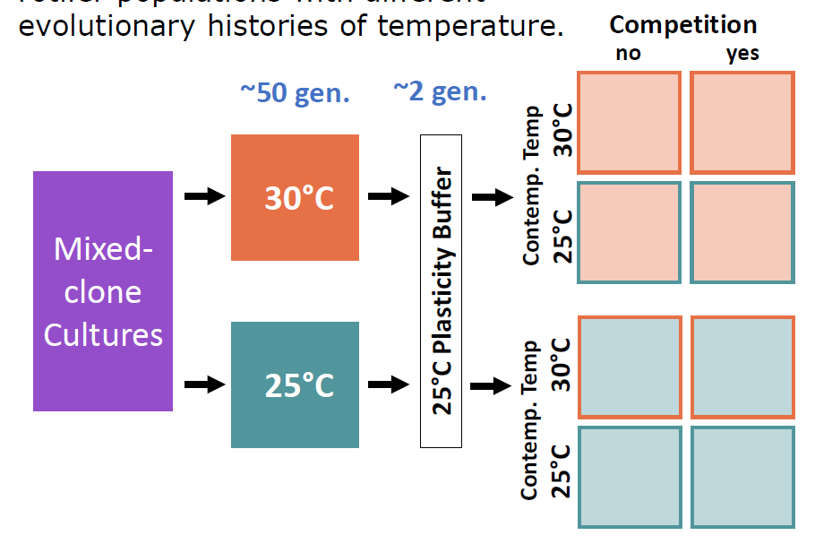
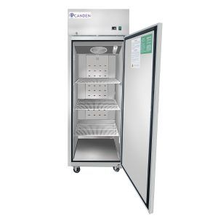
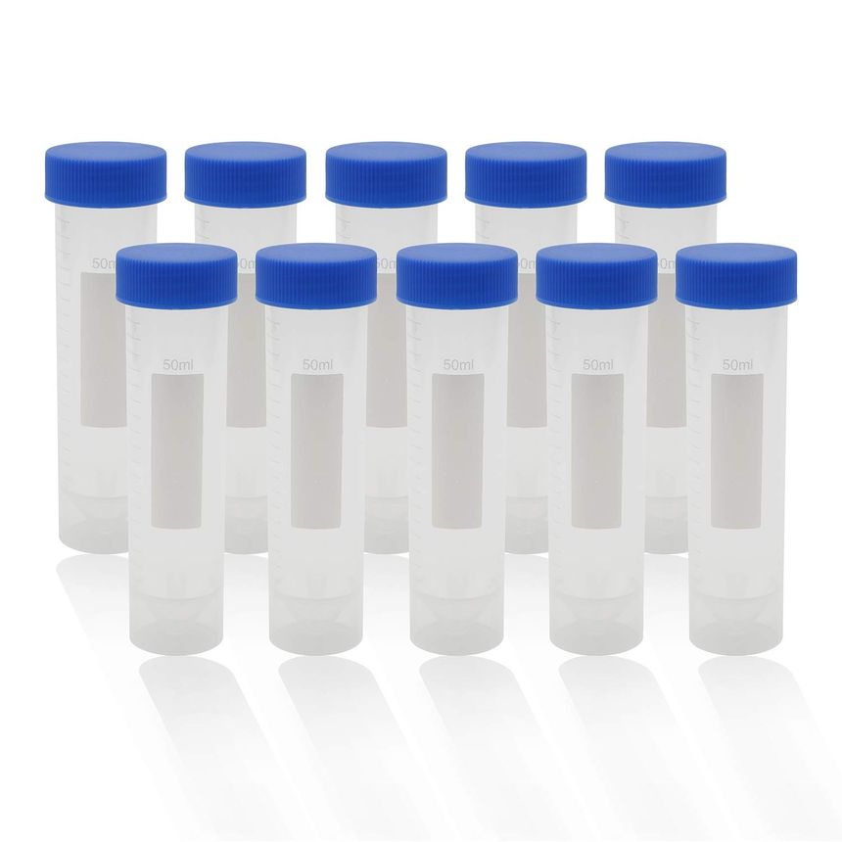
Establishing evolutionary histories of temperature
n = 17 clones were mixed for a diversity in response to temperature
Left to evolve for 50 generation (120 d) in temperature-controlled growth chambers at 25 °C and 30 °C

Slide 19
Evolution and competition experiment
2 generation plasticity buffer after evolution period
80 new cultures established for full crosses of evolved T, contemporary T, and competition
n = 10 for each three-factor cross
Tetrahymena sp. also grown alone at 25 °C and 30 °C
Measured abundance over 16 timepoints to model growth parameters
25 °C
Protists only
25 °C
30 °C
25 °C
Every 6 h
Every 12 h
Every 1 d
Every 2 d
Every 8 d
0d
d21
Notes:
Mention common garden, replace “plasticity buffer”

Slide 20
Do populations of H. rosa evolve in response to temperature?
Rotifers
Protist
Higher Temp
Competition
evolution
Climate Change
Indirect effect
?₁

Slide 21
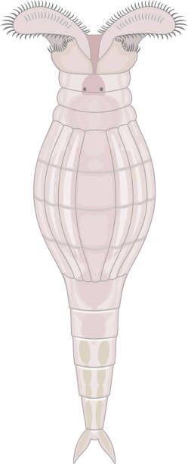
Rotifers that evolved at 25 °C had a higher carrying capacity
Independent of current temperature and competition
K was 13 % higher for cultures that evolved at 25 °C compared to 30 °C
p < 0.001
no effect of evolved temperature on growth rate
p = 0.67
n = 40

Slide 22
2. Are populations of H. rosa affected by competition with Tetrahymena sp.?
Are there evolution-mediated indirect effects of temperature on competition between H. rosa and Tetrahymena sp.?
?₂
Rotifers
Protist
Higher Temp
Competition
evolution
Climate Change
Indirect effect
?₃

Slide 23
Rotifers experiencing competition had a lower carrying capacity
Carrying capacity of H. rosa
Independent of current temperature and evolution
K was 27 % lower for cultures experiencing competition
n = 40
p < 0.001
No competition
Competition
Notes:
Dots? Line color would be weird. No line?

Slide 24
Effect of competition on rotifer r depended on current temperature
Growth rate of H. rosa
At 25 °C competition had a weak effect 31% higher growth rate without competition
At 30 °C competition had a strong effect 98% higher growth rate without competition
Evolution had no effect on competitive response in rotifers
no competition
n = 20
competition
p = 0.03
***
*

Slide 25
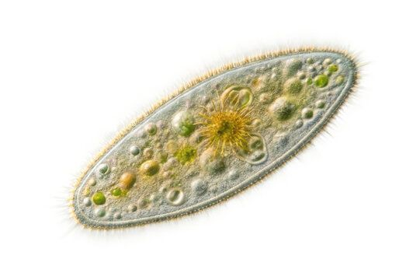
Competitive effect of rotifers on protists dependent on current temperature
Growth rate of Tetrahymena sp.
no competition
n = 20
At 25 °C competition has no effect on protist growth rate
At 30 °C protist r was 46% lower when competing with rotifers that evolved at 30 °C
Evolution had no effect on competitive effect of rotifers on protist growth rate
comp w/ 25 °C evo. rotif.
p = 0.01
comp w/ 30 °C evo. rotif.
ns
*
ns
ns

Slide 26
Competitive effect of rotifers on protists dependent on current temperature
Carrying capacity of Tetrahymena sp.
no competition
At 30 °C competition has no effect on protist carrying capacity
At 25 °C protist r was 40% lower when competing with rotifers
Evolution had no effect on competitive effect of rotifers on protist growth rate
comp w/ 25 °C evo. rotif.
comp w/ 30 °C evo. rotif.
***
***
ns
ns
n = 20
p < 0.01

Slide 27
In summary…
Do populations of H. rosa evolve in response to temperature?
Yes!
Carrying capacity is higher after evolving at 25 °C
2. Are populations of H. rosa affected by competition with Tetrahymena sp.?
Yes!
…but the effect is dependent on temperature
Are there evolution-mediated effects of temperature on competition
between H. rosa and Tetrahymena sp.?
No
Competition did not differ between evolutionary histories of temperature

Slide 28
What I think is happening
Path analysis (either the real thing, or a cartoon version)
Notes:
Acknowledge foods not the same maybe
Talk a bit about tradeoffs between K and r (not something we are used to observing in most systems)

Slide 29
Future directions
Earth’s climate is becoming more variable
Rapid evolution in response to extreme temperature fluctuations

Slide 30
Eco-evo feedback
Species B
Indirect effect
Evolution
Species A
Ecology
Changes in population traits over generations
Biotic and abiotic interactions
Notes:
Explain eco-evo more
Think about it

Slide 31
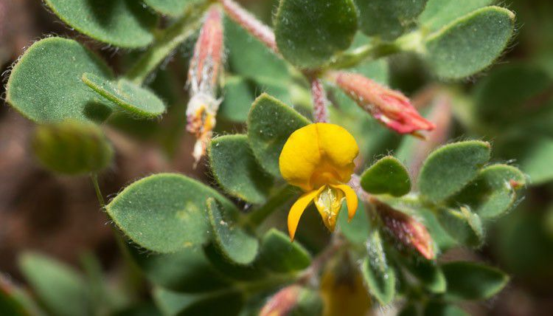
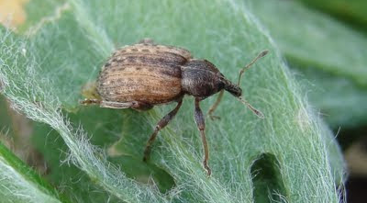
Evolution-mediated indirect effects on ecology
Herbivory
Resistance
Native Plant
Herbivore
Lau, 2012

Slide 32
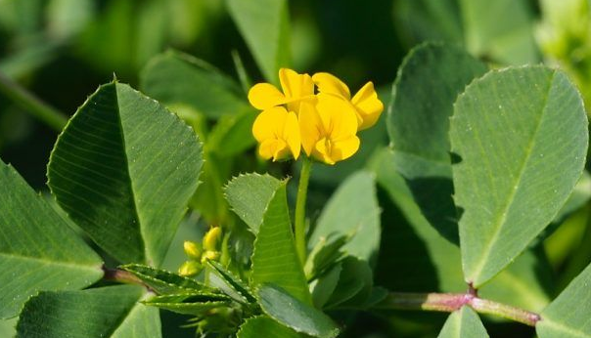
Evolution-mediated indirect effects on ecology
Herbivory
Competition
Resistance
evolution
Native Plant
Herbivore
Invasive Plant
Lau, 2012

Slide 33
Evolution-mediated indirect effects on ecology
Herbivory
Competition
Resistance
evolution
Native Plant
Herbivore
Invasive Plant
Lau, 2012

Slide 34
Do populations of H. rosa evolve in response to temperature?
2. Are populations of H. rosa affected by competition with Tetrahymena sp.?
Are there evolution-mediated effects of temperature on competition
between H. rosa and Tetrahymena sp.?
Rotifers
Protist
Higher Temp
Competition
evolution
Climate Change
Indirect effect
?₁

Slide 35
Do populations of H. rosa evolve in response to temperature?
2. Are populations of H. rosa affected by competition with Tetrahymena sp.?
Are there evolution-mediated effects of temperature on competition
between H. rosa and Tetrahymena sp.?
?₂
Rotifers
Protist
Higher Temp
Competition
evolution
Climate Change
Indirect effect

Slide 36
Do populations of H. rosa evolve in response to temperature?
2. Are populations of H. rosa affected by competition with Tetrahymena sp.?
Are there evolution-mediated indirect effects of temperature on competition between H. rosa and Tetrahymena sp.?
Rotifers
Protist
Higher Temp
Competition
evolution
Climate Change
Indirect effect
?₃

Slide 37
Trait measurement
Growth parameters
Rotifer and protist abundance measured over 21 d
Sampling interval increased over time
Total of 16 timepoints
Logistic growth model
growthrates package (v.0.8.4) in R (v.4.5.1)
Maximum growth rate (r)
Carrying capacity (K)
r = 0.6154
K = 77.1889
Every 6 h
Every 12 h
Every 1 d
Every 2 d
Every 8 d
0d
1d
1.5d
2d
2.5d
3d
4d
7d
9d
13d
21d
d22
6h
18h
Notes:
Fewer sig figs on r and K
Try full line without breaks, strike day labels, with all 16 timepoints

Slide 38
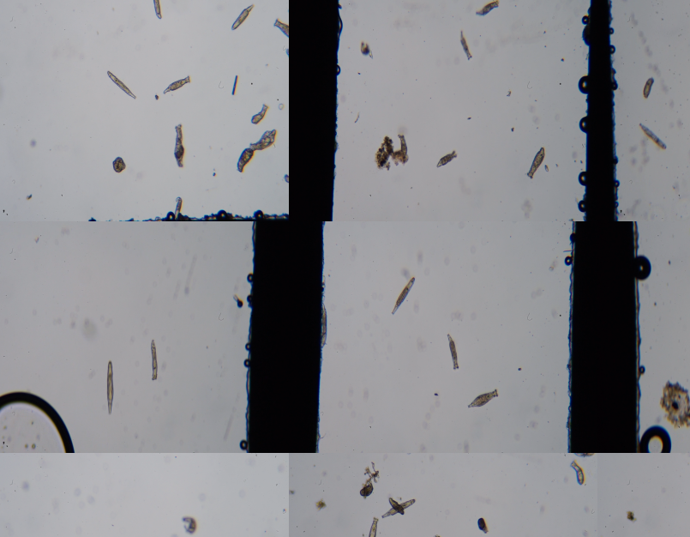
Trait measurement
Size
Rotifers imaged at the beginning of the experiment
n > 200 for each evolutionary history
Data to be analyzed!
Size measured
Every 6 h
Every 12 h
Every 1 d
Every 2 d
Every 8 d
0d
1d
1.5d
2d
2.5d
3d
4d
7d
9d
13d
21d
d22
6h
18h

Slide 39
Analyses
Rotifer growth rate (r) and carrying capacity (K)
3-way ANOVA
Fixed factors:
evolved temperature (30 °C, 25 °C)
contemporary temperature (30 °C, 25 °C)
competition (true, false)
Protist growth rate (r) and carrying capacity (K)
2-way ANOVA
Fixed factors:
contemporary temperature (30 °C, 25 °C)
competition
no competition
rotifers evolved @ 25 °C
rotifers evolved @ 30 °C
Transformations
All growth rate data were ln-transformed to meet test assumptions
Post-hoc comparisons
p-values adjusted using Tukey’s HSD
Notes:
No (Type III)

Slide 40
Rotifers that evolved at 25 °C had a higher carrying capacity
Independent of current temperature and competition
K was 13 % higher for cultures that evolved at 25 °C compared to 30 °C
no effect of evolved temperature on growth rate (p = 0.67)
Growth rate
Carrying capacity
ns
p < 0.001
r (± SE)
K (± SE)
n = 40
Evolved temperature (°C)

